Slide 1
Access to English
Marina and Lucy

Slide 2
Why This Topic?
Hunger in America or Learning English
Interest in linguistics
TESOL Teacher is goals
Genie Wiley

Slide 3
Research
Scientific
Language comprehension is complex and is subconsciously achieved through many strategies
Context, linguistics, general knowledge
Second language learners often use other strategies to comprehend language instead of paying attention to form
Everything Else
worldwide limit of 675,000 permanent immigrants
How many people the United States let in from all over the world with all different sorts of situations.
Being able to communicate (or not) affects every area of life in which we have to interact with others.
Most immigrants admit that knowing what is available in the first place is a huge barrier.

Slide 4
Interviews

Slide 5
Expert
Jin-Suk Byun, an assistant professor at Alliant University
There are several methods of teaching english
Grammar-translation, audio-lingual, “linking” etc.
The best way to teach a language depends from person to person and often a combination of methods work together
Languages are complicated
With a good teacher and enough help, you can learn a language

Slide 6
Advocate
Glenn - TESOL Teacher at HTHI
Finding Spanish was like “a caveman finding fire for me”
English: Unphonetic, tons of smelling exceptions,
Fluency can be affected by pronunciation
Learning a language makes you smarter
You need more then enough English to just get by to have a good life
Knowing a language and understand linguistics of a language is different

Slide 7
“Opposer”
Maria Hernandez- Someone living in America who speaks little English
Entered ESL class but had to leave and never got back into one
Now able to take classes online
Not speaking English affected quality of life - Could have a better job
People feel like they can’t represent their computers if they don’t speak English
We need cheap and convenient ESL classes for immigrants to help them feel motivated to learn.

Slide 8
Victim
Eloisa, who immigrated from Mexico when she was 16
She learned English through the ESL program in High School
“If you go to a country you should learn their language and merge into their culture, not to say you should lose your own culture”
She was very motivated to learn English and build a life here
She sometimes struggled in school because she couldn’t communicate well with teachers
She feels like she will never really be completely fluent even though she has lived in California for around 30 years

Slide 9
Immersion Experience

Slide 10
The Movie
Marina-watched the French movie “LOL”
I was totally lost
I was really confused on who the characters were
At first it was really weird but I eventually got used to hearing it
Lucy-watched the Italian movie “The Bicycle Thief”
I Understood what was going on
Boring
Felt longer than normal
Kept getting distracted

Slide 11
Ordering Food
Marina:
It felt awkward and weird trying to speak Spanish to someone who is fluent when I am not fluent​
It was hard to not speak English
It went ok and the cashier didn't seem to notice so honestly it wasn't that bad
Lucy:
Actually the worst thing ever
Extremely Embarrassing
I was a Koreaboo.

Slide 12
Videos
Ordering Food
Reflection

Slide 13
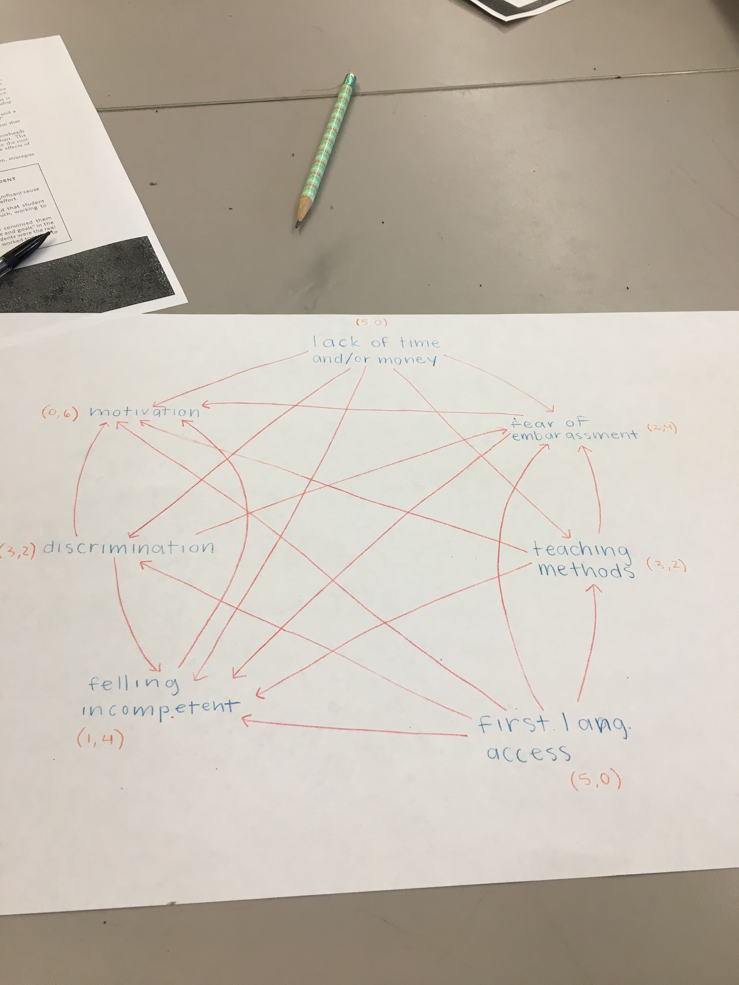
Problem Statement
We need cheap and convenient ESL classes for immigrants to help them feel motivated to learn.

